Slide 1
LSTMs & GRUs

Slide 2
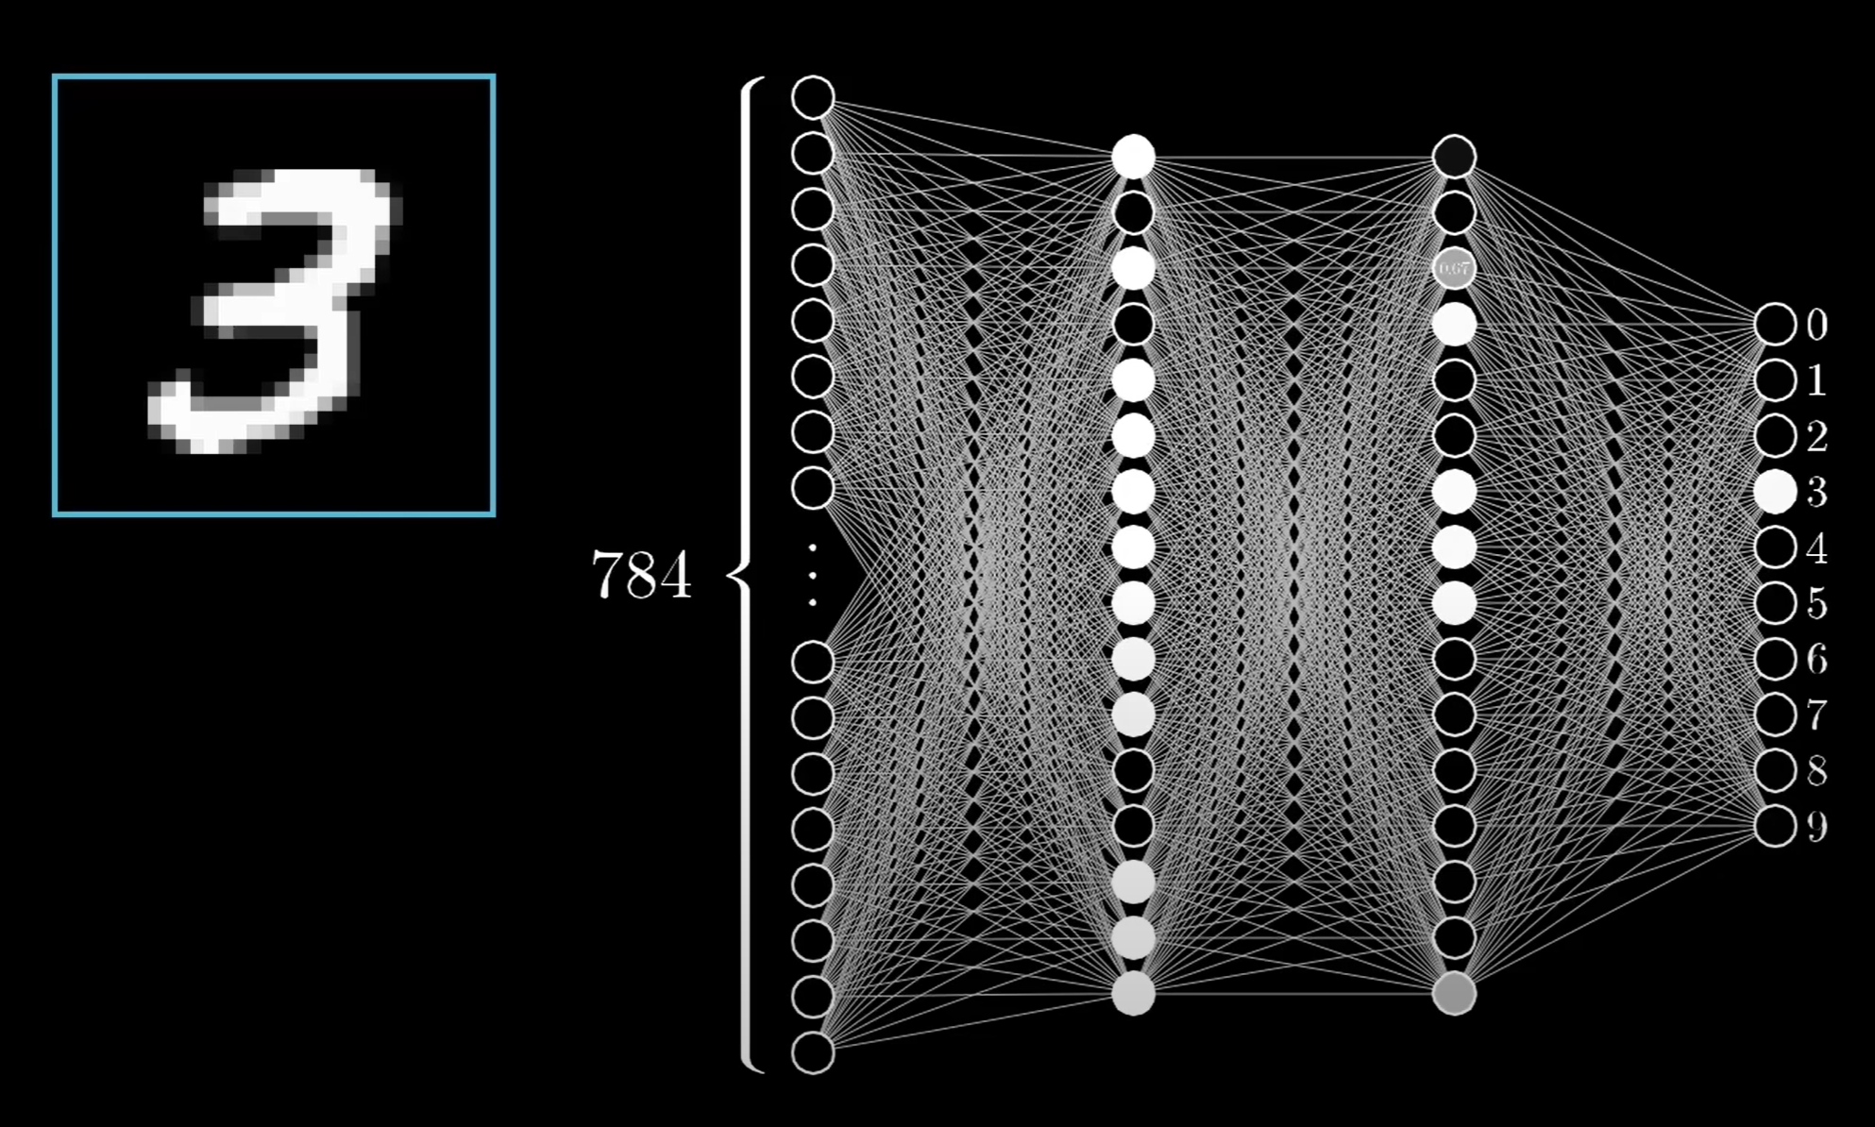
Overview - What Are Neural Networks?
(Feed-Forward Neural Networks)
Neuron
Hidden Layers
Neuron: Receives input from other neurons or the external world and computes a weighted sum of inputs
Connections: Adjustable parameters determining connection strength (weight and bias)
Input Layer: Receives external data as the initial input
Hidden Layers: Multiple layers that process and extract data features
Output Layer: Provides final predictions or outcomes
Optimization Algorithm: Updates weights and biases to minimize errors (Function cost/Loss Function & Backpropagation)
Connections
Output Layer
Input Layer

Slide 3
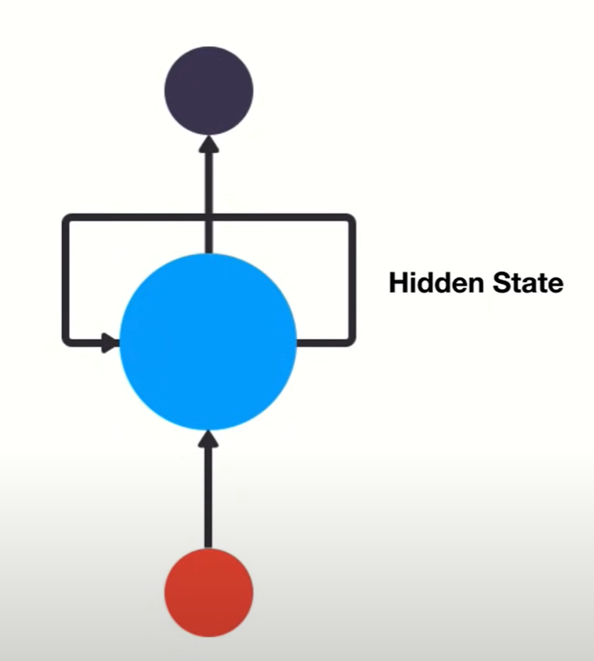
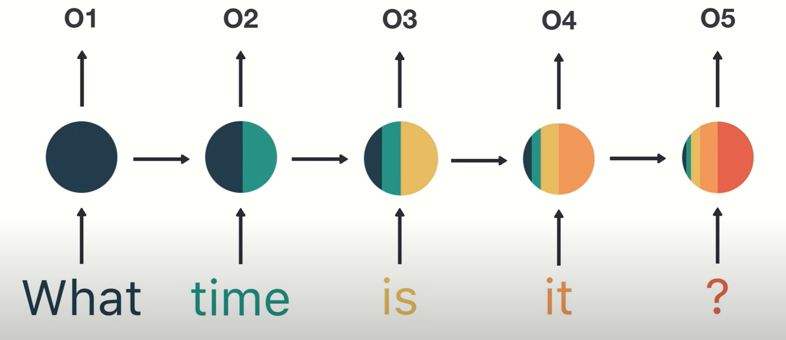
Recurrent Neural Networks
Good for modeling sequence data for predictions by utilizing “sequential memory”
Contains a data highway that allows information (inputs) to flow from one step to the next (outputs)
Suffers from short-term memory caused by the vanishing gradient problem
VGP is caused by the nature of backpropagation
Gradients are used in the optimization algorithm to adjust the network’s weights allowing them to learn and is reduced from layer to layer

Slide 4
What are LSTMs and GRUs?
LSTMs (long short-term memory networks) and GRUs (gated recurrent units) are different types of RNNs
RNNs (recurrent neural networks) process sequential data
Both are designed to address the “vanishing gradient” problem in RNNs
When gradients of weights in network become very small and the network has difficulty learning
Gradients are values used to update a neural network’s weights
They were basically created to address the issue of short-term memory in RNNs

Slide 5
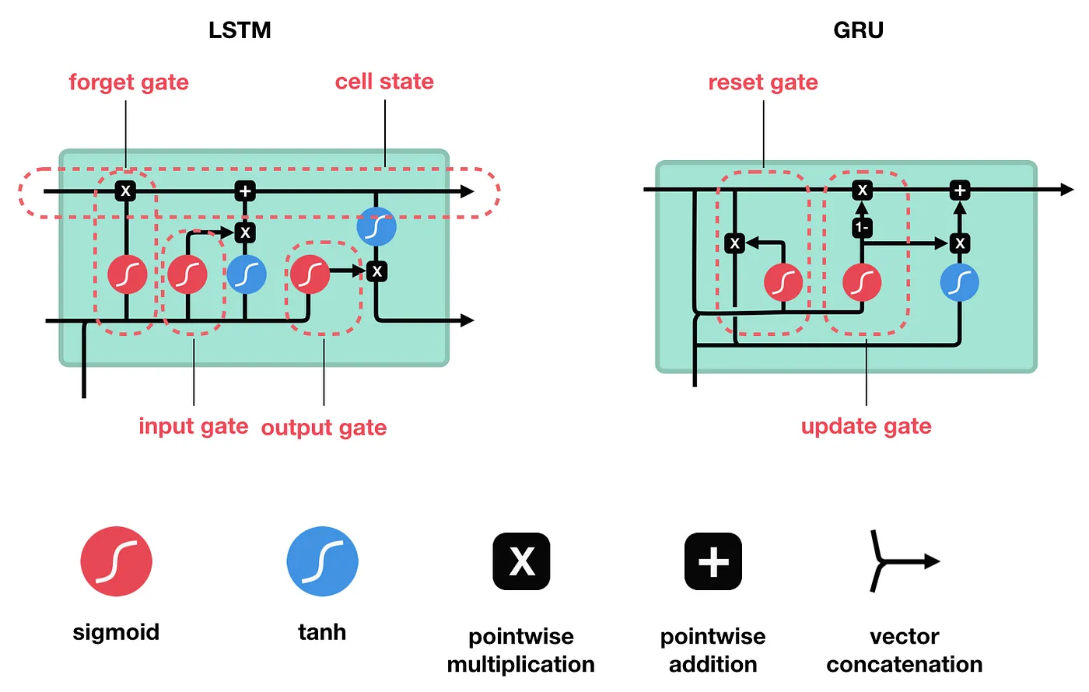
How exactly do they work?
LSTM
Uses a special type of memory cell to store and output information
The memory cells are made to remember information for long periods of time
They do this by using “gates” to control the information that goes in and out of the cell
GRU
Uses a single “update gate” to control the flow of information into a memory cell
It is basically a simplified version of LSTMs
Instead of the three gates in LSTMs, a GRU has one “update gate”

Slide 6
How exactly do they work?
The operations within the networks are used to help them keep or forget info
They help regulate the values that move through the network
In LSTM:
Forget gate: decides what’s relevant to keep
Input gate: decides what’s relevant to add
Output gate: decides what next hidden state should be
In GRUs:
Update gate: decides what info to throw away & what new info to add
Reset gate: decides how much past info to forget

Slide 7
Long Short-Term Memory
PROS:
Modeling long-term dependencies since it can selectively remember or forget information over time.
Useful for tasks such as speech recognition, machine translation, and text generation.
Better against noisy/missing data as it can selectively filter data at the forget gate.
More flexible and interpretable since it can hold the network’s memory at each time step.
CONS:
Expensive to train and evaluate
Prone to overfitting (giving accurate prediction for training data but not new data) on smaller data sets
Large amount of training data required to learn complex patterns

Slide 8
Gated Recurrent Unit
PROS:
Easier to train and faster to run than LSTM models. (Fewer Parameters)
Can handle somewhat long term dependencies by selectively remembering/forgetting previous inputs.
Perform well on tasks such as natural language processing, speech recognition, and music generation.
CONS:
May not be as effective at storing and accessing very long-term dependencies or complex sequential patterns.
More prone to overfitting than LSTMs.
May not be as interpretable since the gating mechanics make it difficult to understand how exactly predictions are being made

Slide 9
Resources
Overview of LSTM & GRU - https://www.shiksha.com/online-courses/articles/rnn-vs-gru-vs-lstm/#
How LSTM’s and GRU’s Work - https://towardsdatascience.com/illustrated-guide-to-lstms-and-gru-s-a-step-by-step-explanation-44e9eb85bf21
Understanding LSTM: https://medium.com/@anishnama20/understanding-lstm-architecture-pros-and-cons-and-implementation-3e0cca194094
Understanding GRU: https://medium.com/@anishnama20/understanding-gated-recurrent-unit-gru-in-deep-learning-2e54923f3e2

Slide 10
Resources
Neural Network Overview - https://youtu.be/aircAruvnKk?si=SQI96oQUlqiJWnKP
Gradient Descent - https://youtu.be/IHZwWFHWa-w?si=BoNyJBZ6M7ccBDFX
Backpropagation - https://youtu.be/Ilg3gGewQ5U?si=Fcjjd30BDgxpWVHT
RNN Overview - https://youtu.be/LHXXI4-IEns?si=7_d5h2SWgQ71Wbbb
LSTM & GRU Overview - https://youtu.be/8HyCNIVRbSU?si=8kP4dcG85fGxDjVi

